Slide 1
Topic 5 (Progressive Era) Writing Discussion Assignment (Directions for Assignment)
As they say, a picture is worth a thousand words, making political cartoons useful primary sources to understand the past. They come with a bias, of course, as do most primary sources. They reflect the viewpoint of their author or the publication they appear in. Nevertheless, they can summarize and cut to the heart of hot button issues of the day with imagery and a minimum of text. Most people of that day looking at them would have understood what is going on in them because they would be familiar with the iconography being used. But for us today, looking back on them, they need to be deciphered to be understood. That’s your job.
In this PowerPoint are 11 slides from the Progressive Era, a period of wide-ranging liberal reforms at the local, state, and national levels during the first two decades of the twentieth century. You are to examine one of them (completely up to you which you choose) and explain them to us. (Note: some of the slides have more than one cartoon addressing the issue; you can examine them both or just one.) What is the issue or problem they are addressing? What do the different elements/people/images represent? What is the author trying to say? What is his/her take on the issue, his/her bias?
The textbook reading should provide you a lot of information you will need for this assignment. But you can also go online to learn more about specific elements in these cartoons.
Your write-up should run between 150-200 words.
It must be submitted via Canvas by no later than midnight, Sunday, September 29.

Slide 2
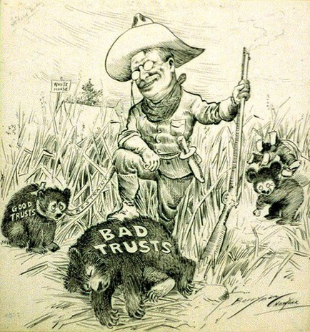

Slide 3
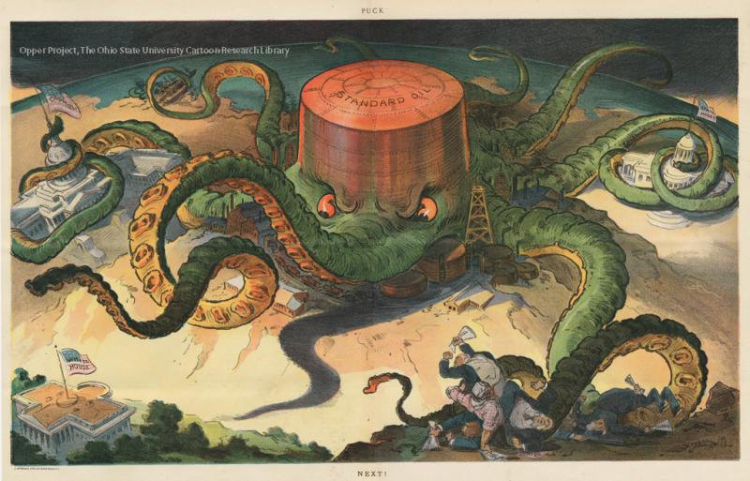

Slide 4
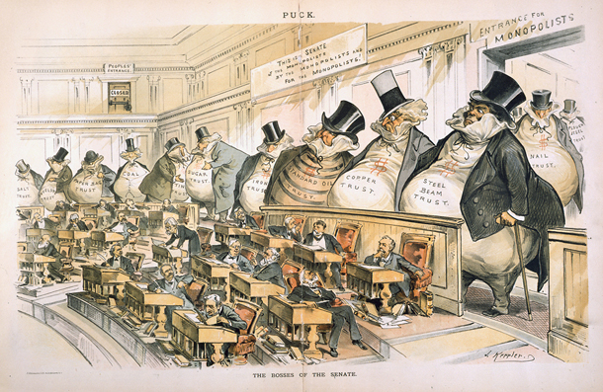

Slide 5
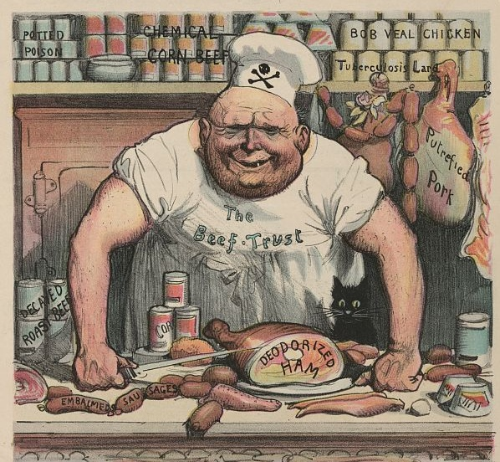

Slide 6
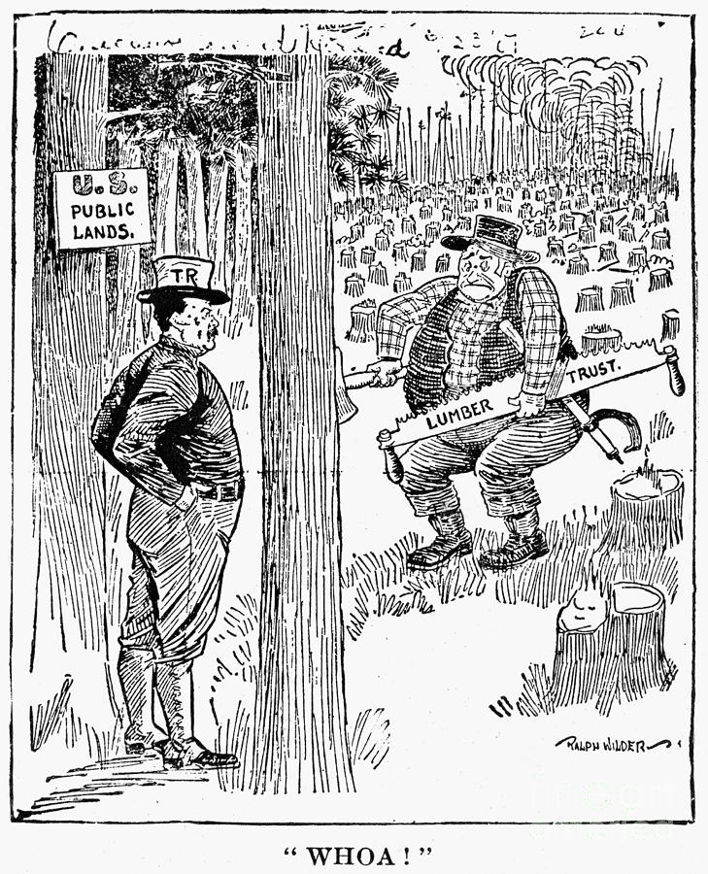
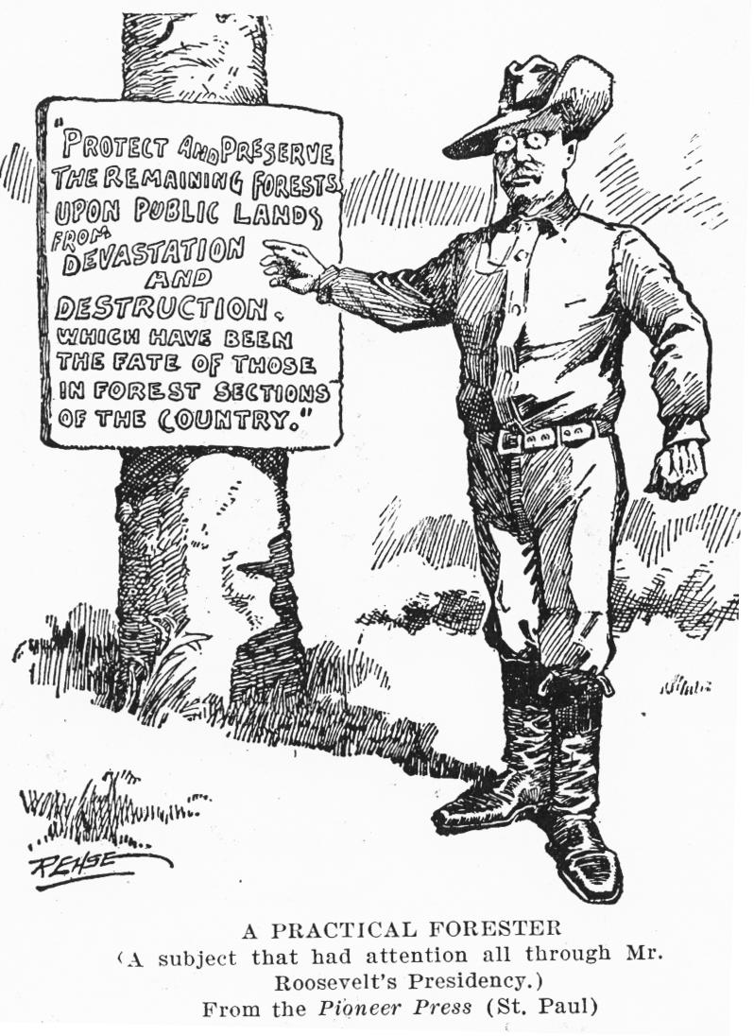

Slide 7
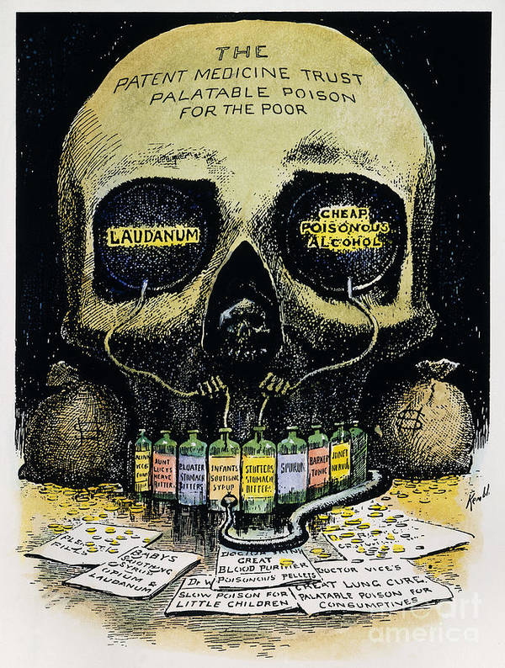

Slide 9
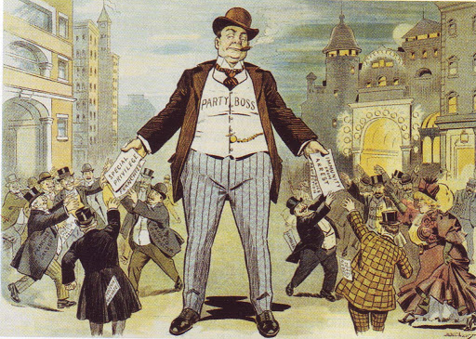

Slide 10
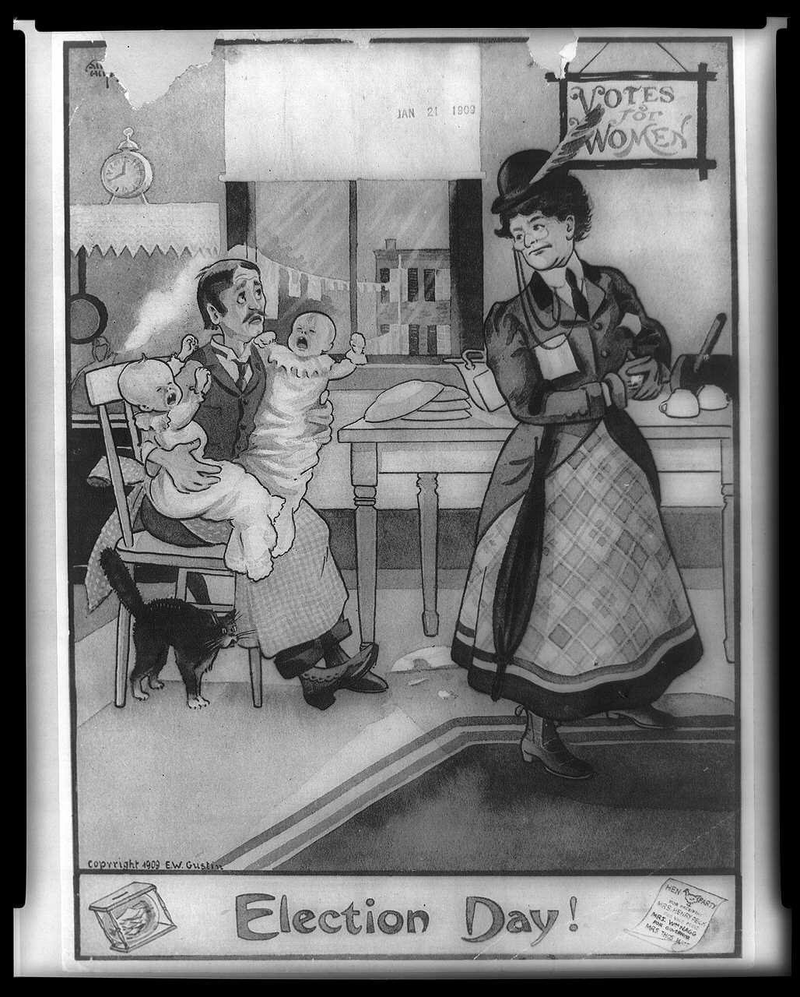
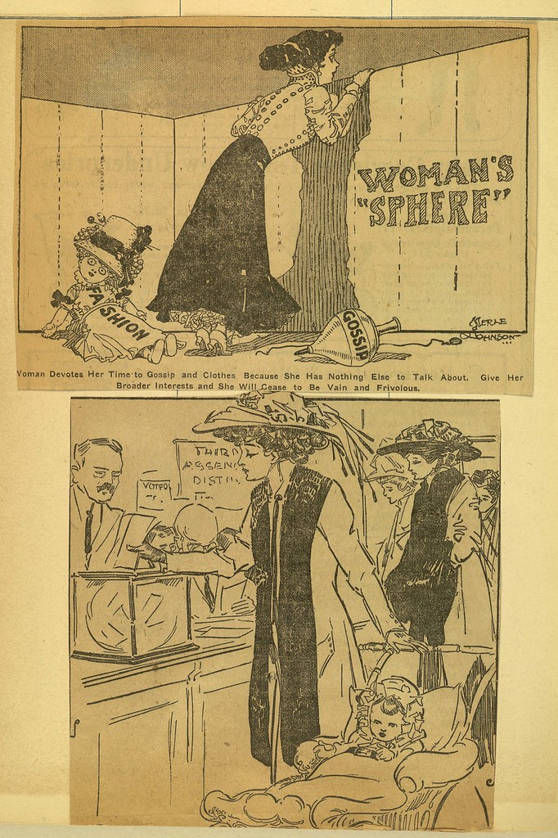

Slide 11
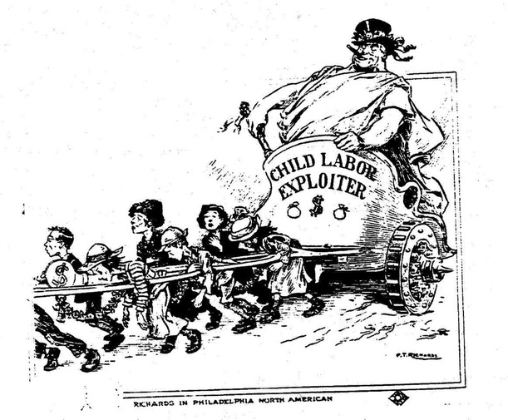

Slide 12
